Slide 1
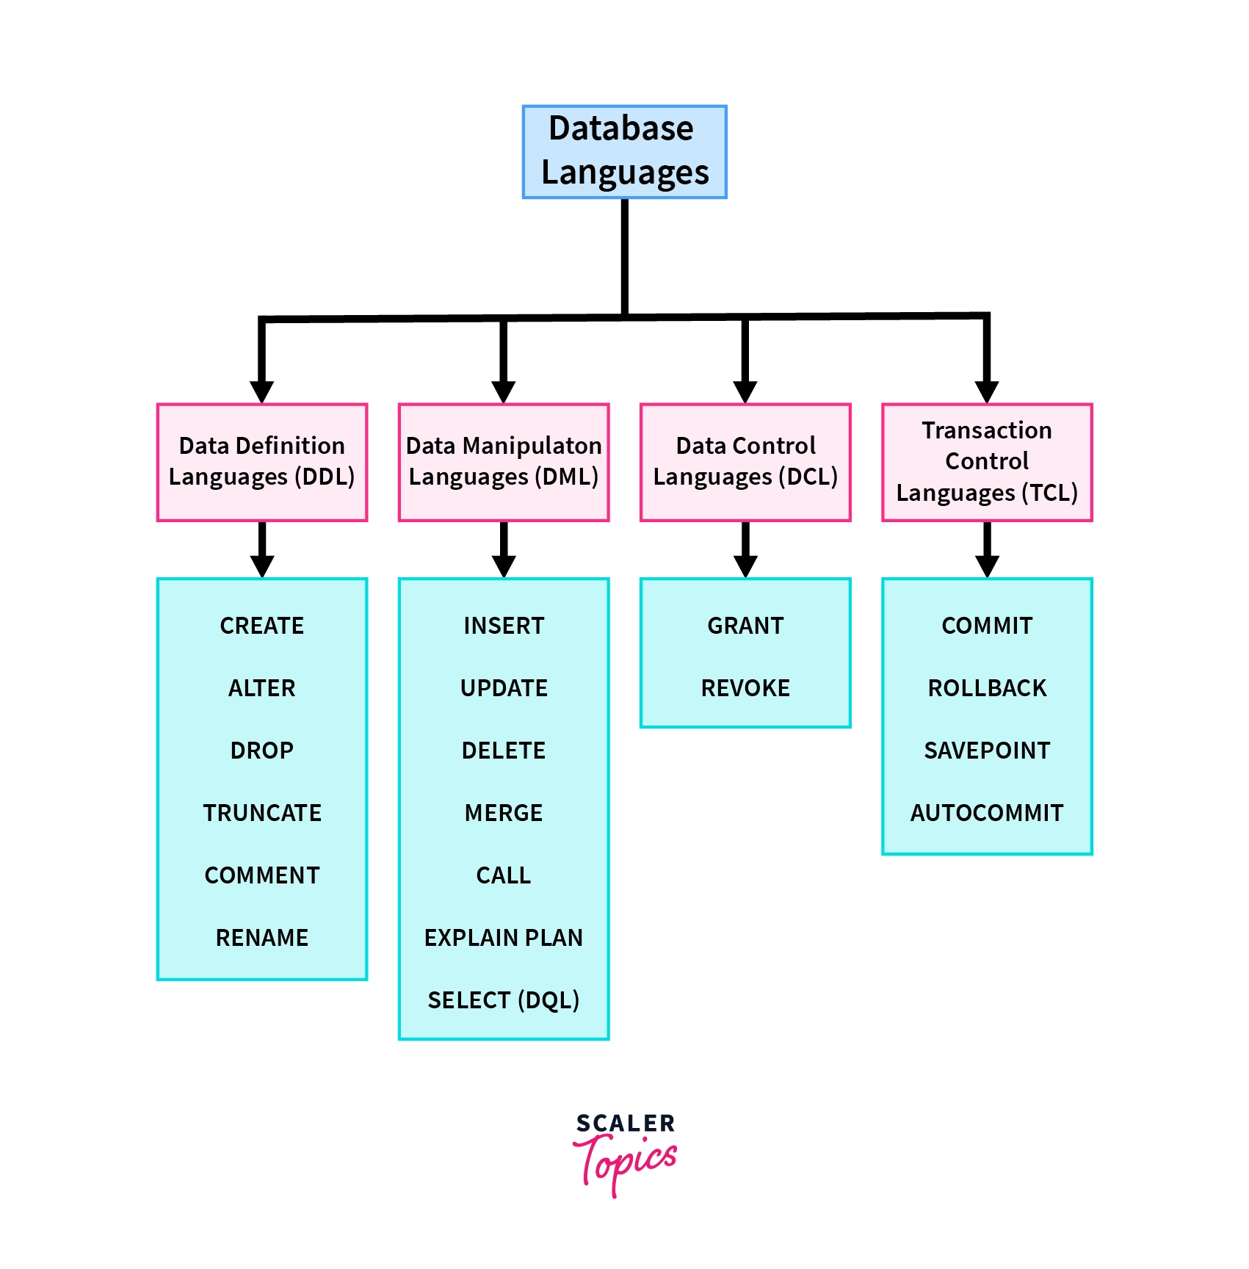

Slide 2
Data Definition Language (DDL)
Data Definition Language (DDL) is a set of special commands that allows us to define and modify the structure and the metadata of the database. These commands can be used to create, modify, and delete the database structures such as schema, tables, indexes, etc.

Slide 3
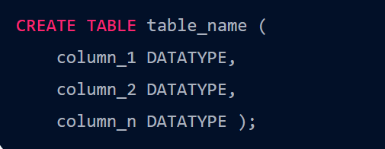

Slide 4
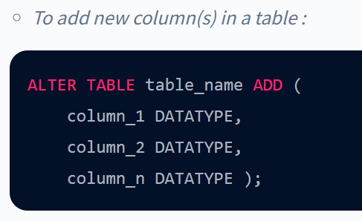

Slide 5
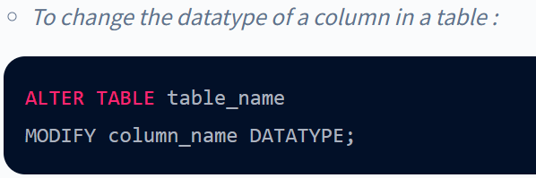

Slide 6
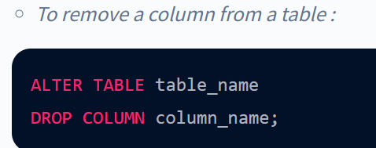

Slide 7
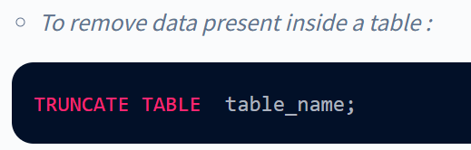

Slide 8
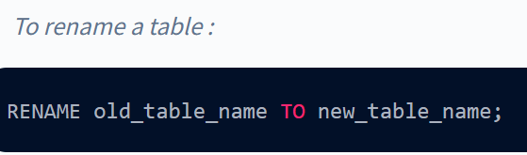

Slide 9
